Slide 1
River Recreation and Stewardship Opportunities

Slide 2
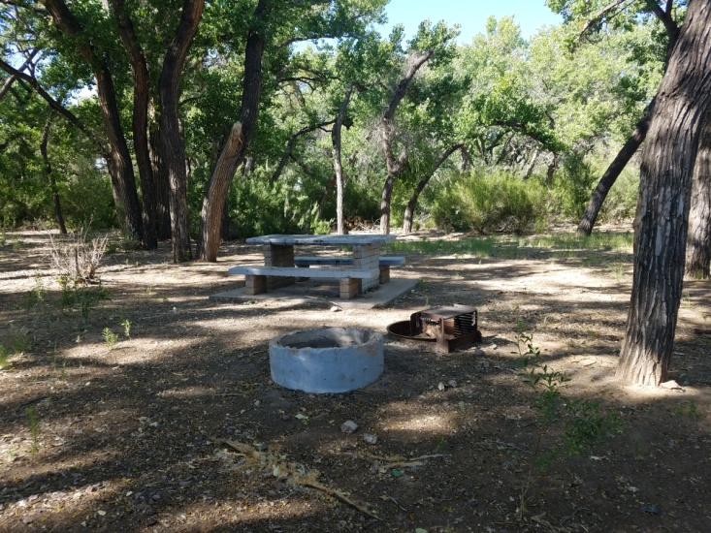
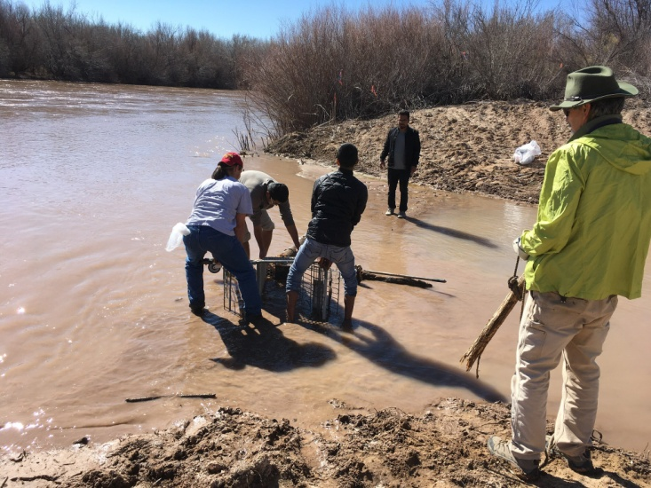
Recreation and Stewardship
Riverine Parks
Socorro Valley Bosque Trail
Socorro Nature Area
Bosque Trash Pickup Days
Agency Work Days
Volunteer Planting Days

Slide 3
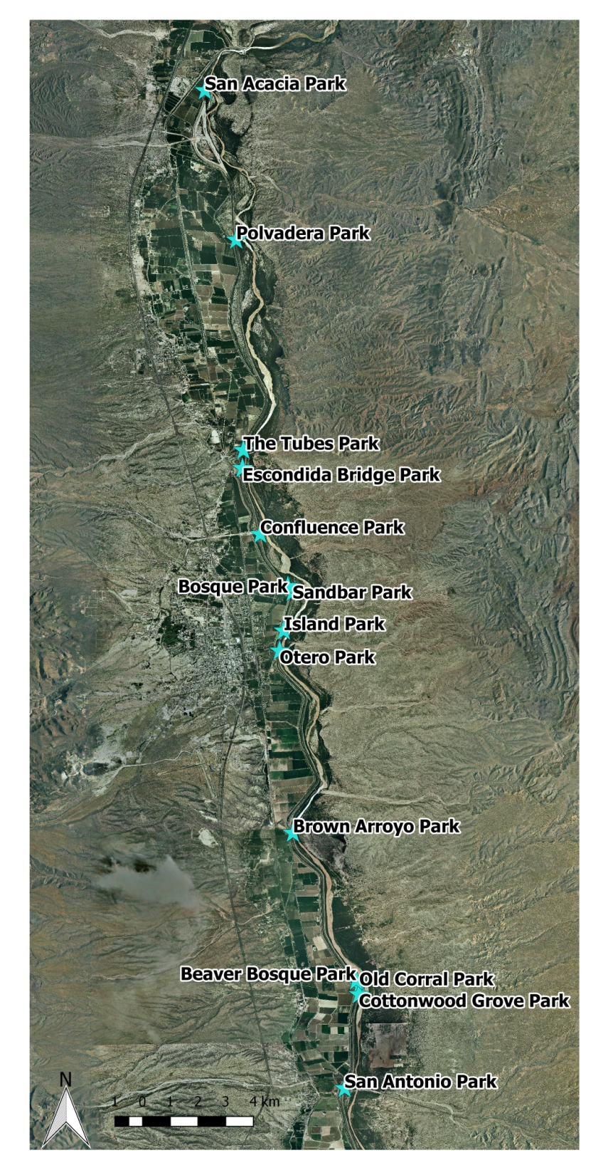
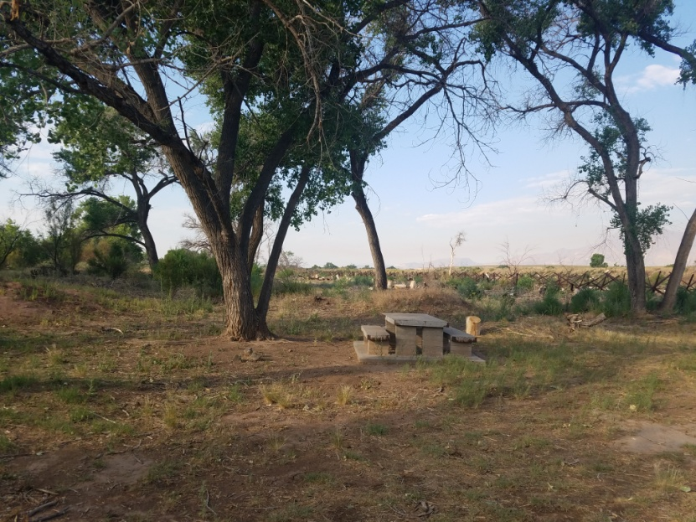
Riverine Parks
Picnic tables and fire pits
Ramps from levee
San Acacia – most northern
San Antonio - southernmost

Slide 4
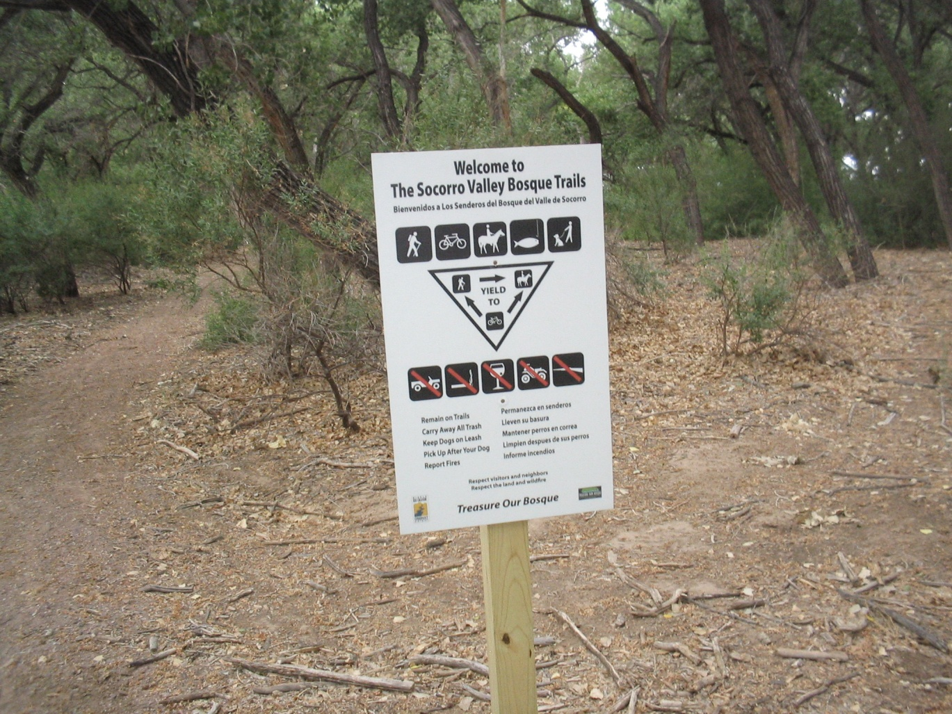
Socorro Valley Bosque Trail
Otero Street Park to Confluence Park ~ 3 miles

Slide 5
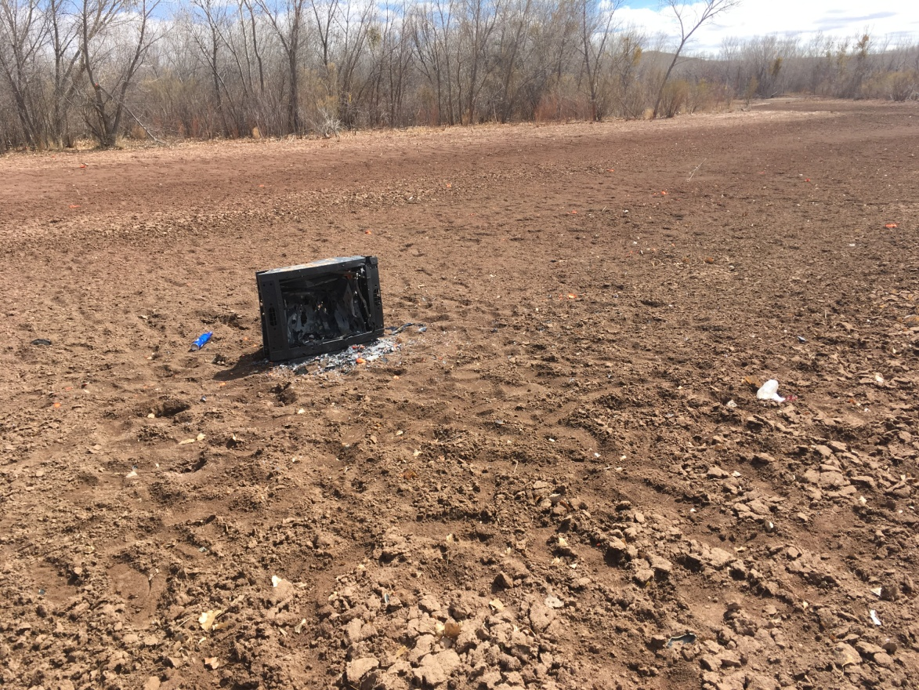
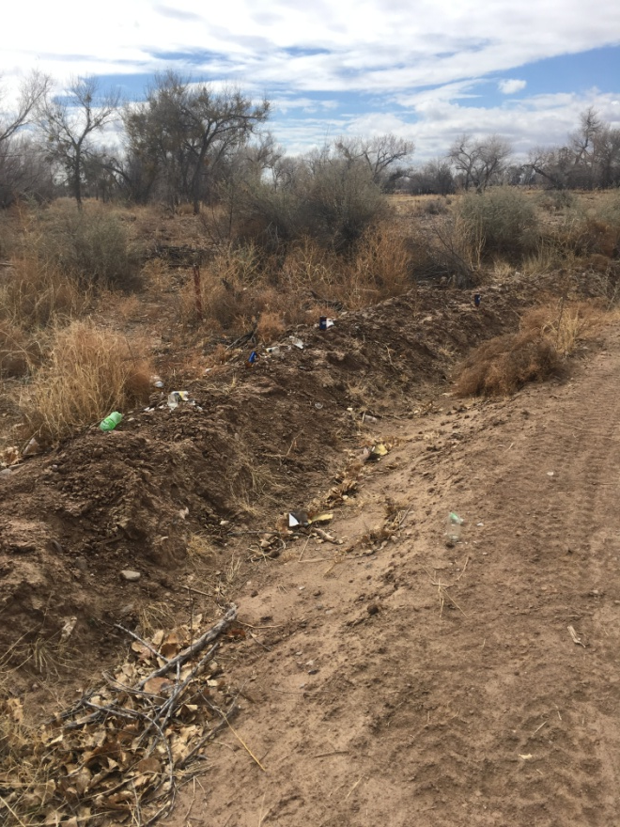
Spring Trash Pickup
April 19, 2018
9 am – 12 pm - Meet at Otero Street Park

