Slide 1
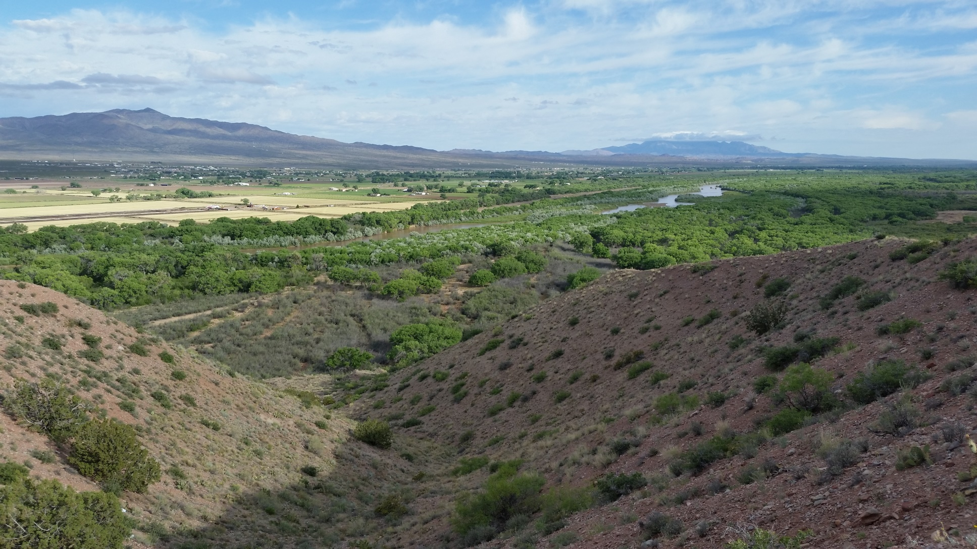
Save Our Bosque Task Force Restoration Partners and Projects 3 Highlighted Efforts
Gina Dello Russo
Notes:
Describe greater floodplain and valley infrastructure

Slide 2
Socorro County’s FEMA Wildfire Hazard Mitigation Program
Socorro Valley: 1351 acres
Socorro County North Bosque: 557 acres
Save Our Bosque Task Force is:
Monitoring treatment areas
Providing all mapping products
Serving as inspectors for the projects

Slide 3
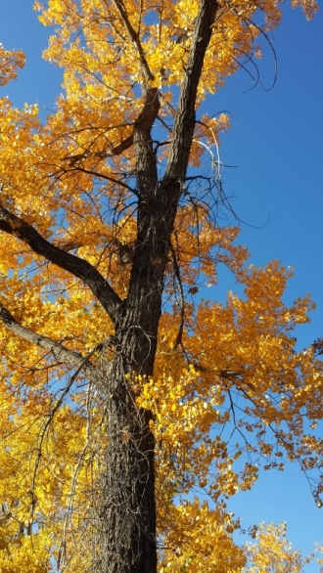
Draft Schedule of Project
Phase 1
Environmental Compliance 2017-2018
Monitoring 2017-2018
Research 2017-2018
Application revision - 2018
Awards of Phase 2 - 2018
Phase 2
Invasive control 2018-2019
Native planting 2019-2020
Monitoring & Research 2018-2020, beyond

Slide 4
Tiffany Fire Rehabilitation
9,200 acres burned in 2017
Phase 1 – grant funding request
Analysis
Planning
Site Preparation
Environmental Compliance
Lead Entities:
Sierra SWCD
SOBTF
Turner Enterprises
Bureau of Reclamation

Slide 5
Step 1: Analysis
Task | Scope | Lead
River Slope | Historic and predicted | Reclamation
Sediment Movement | Historic and predicted | Reclamation
Surface flow patterns | Historic and predicted | Reclamation
Vegetation | Historic and predicted | SSWCD, Contract
Groundwater | Historic and predicted | SSWCD, Contract
Topographic survey | Mesa to mesa; mid refuge to RM 60 | Reclamation or SSWCD, Contract
Soil survey | Level 1 & 2 | SSWCD, Contract
Private Lands Options | All major landowners | SSWCD, Contract
Depletions Analysis | Historic and predicted | Reclamation, Contract
Synthesize information | Summary Reports and Findings | SOBTF, Turner Enterprises, Contract

Slide 6
Step 3: Site Preparation
Save Our Bosque Task Force
Looked at Goodding’s willow-dominated areas, places to treat invasive species within one growing season of fire
Approximately 400 acres
Initial monitoring will inform final site preparation areas and techniques

Slide 7
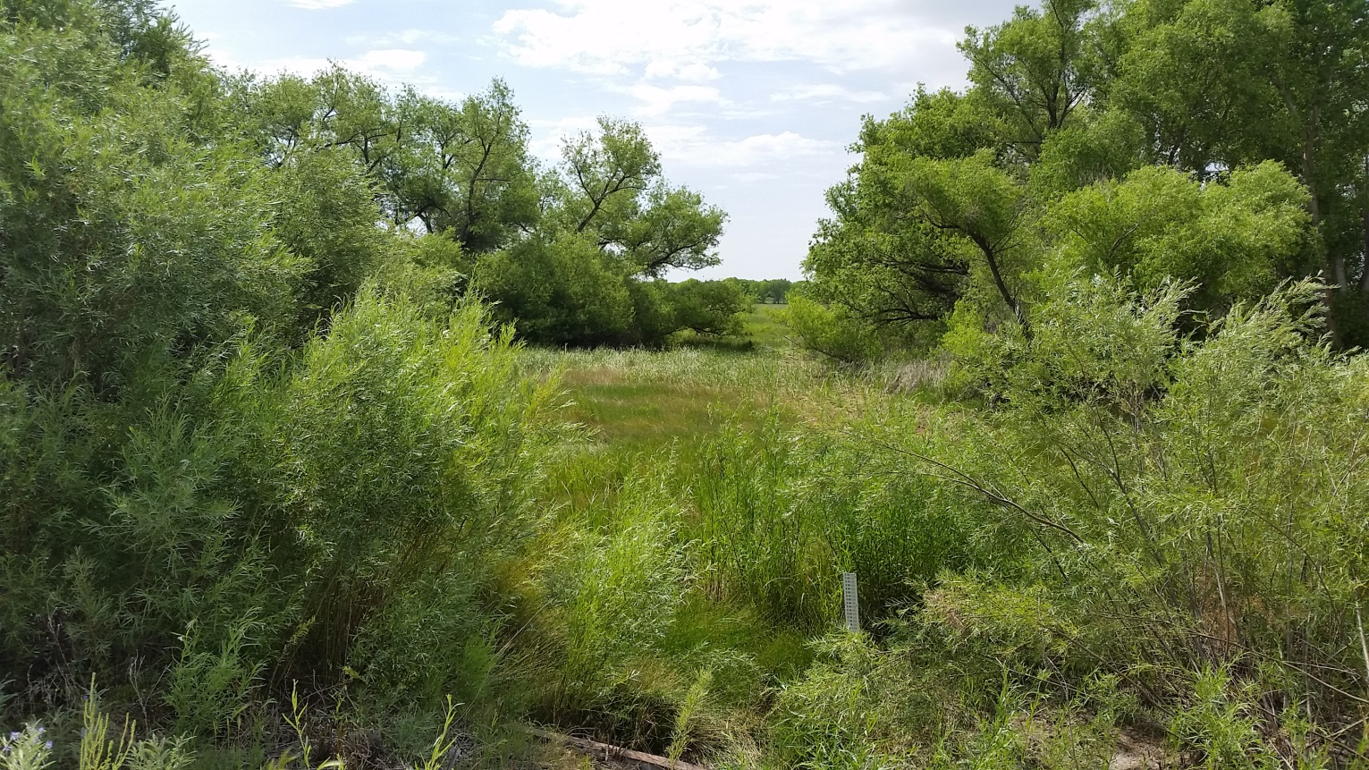
Current Restoration Partners
Sierra
Soil and Water
Conservation
District
Save Our Bosque
Task Force
Bureau of
Reclamation
Turner
Enterprises
& other Private
Landowners
NM State
Forestry
BLM and FWS
Rio Grande
Agricultural
Land Trust
Socorro
County

Slide 8
Save Our Bosque Task Force and USFWS Partners for Fish & Wildlife Program
To enhance wildlife habitat along the Rio Grande through habitat conservation projects
Project status
Completed = 257 acres
In Progress = 80 acres
In Planning > greater than 60 acres

Slide 9
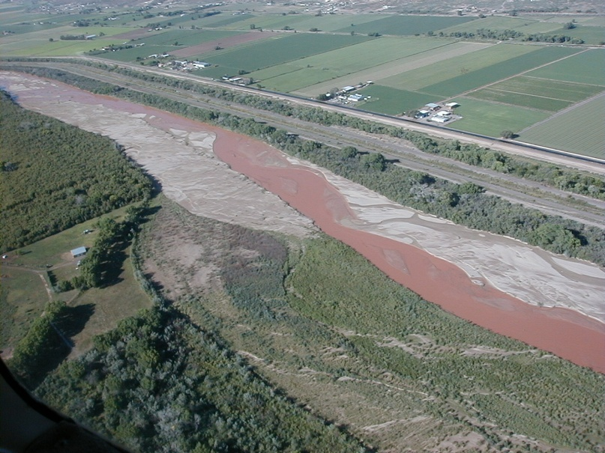
Synergy Building on the Rio Grande in Rural New Mexico
Non-profit organizations working on common goals
As a group we are stronger than we are individually
We have common needs to build success
Shared positions
Collaborative grants, projects
Sharing successes with our community & larger area interests
Greater outreach opportunities
Learning from each other

Slide 10
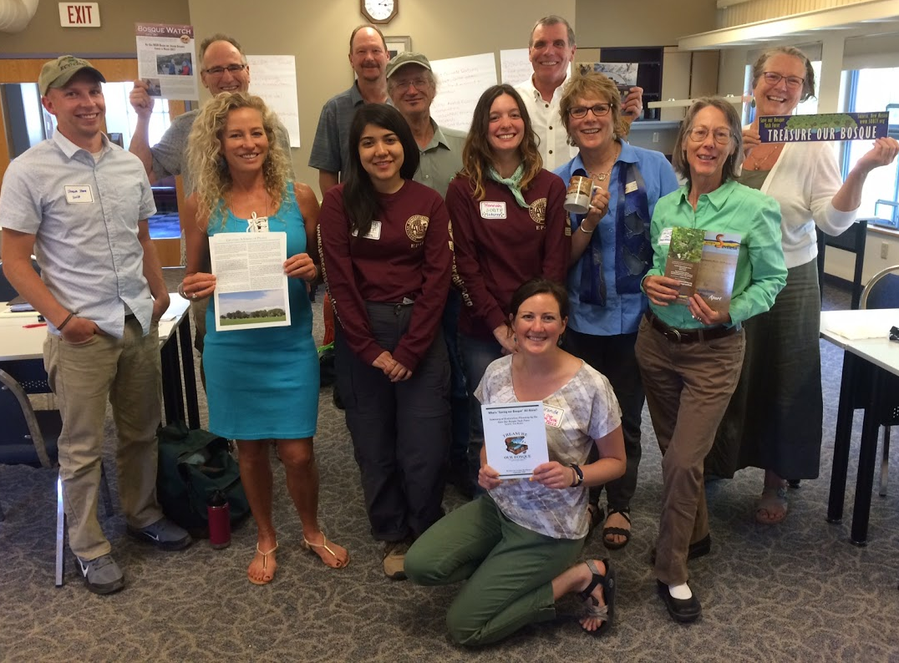
Who Are We….So Far
Rio Grande
Agricultural
Land Trust
Save Our Bosque
Task Force
Amigos de
Sevilleta
Southwest
Grass-Fed
Livestock
Association
Southwest Seed
Partnership
Rio Grande
Return
Friends of
Bosque del
Apache
Diamond in the
Desert (invited)
MRG Economic
Development
Association
The
Wilderness Society
local chapter

