Slide 1
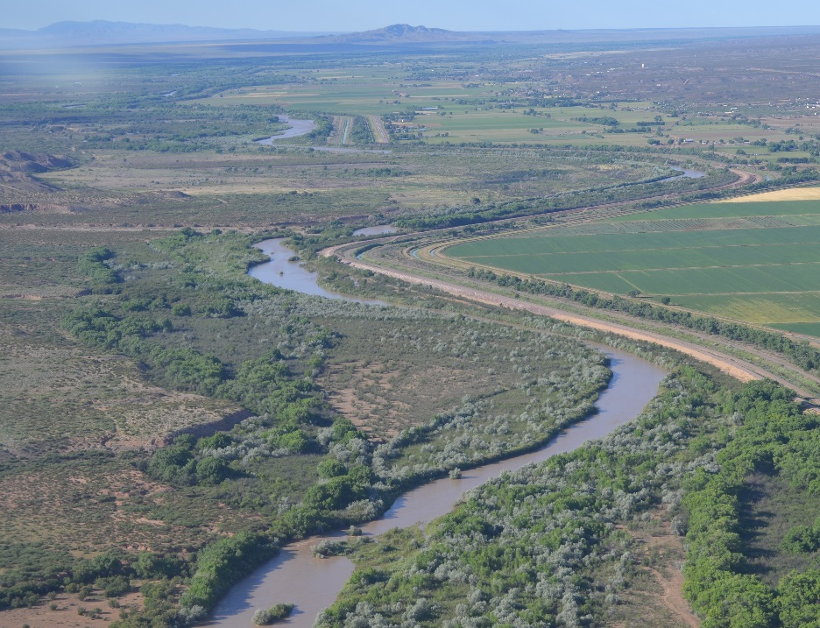
As part of the Final Biological and Conference Opinion for Bureau of Reclamation, Bureau of Indian Affairs, and Non-Federal Water Management and Maintenance Activities on the Middle Rio Grande, New Mexico
US Fish and Wildlife Service Consultation Number 02ENNM0002013-F-003
2 December 2016
LOWER REACH PLAN – DRAFT
Public Overview at Save our Bosque Task Force Public Meeting
March 13, 2018

Slide 2
Lower Reach Plan - Objective
The objective for the Lower Reach Plan comes from the 2016 BiOp as part of Reasonable and Prudent Measure 9. As part of this requirement, Reclamation will develop a Lower Reach Plan to coordinate Reclamation, State, and MRGCD activities from Isleta Pueblo southern boundary downstream to the Elephant Butte headwaters. It will lay out activities performed by Reclamation and our BiOp partners as well as other entities that are outside the BiOp in the area.
This plan will include multiple planned river maintenance and endangered species habitat projects to provide a cohesive approach for this critical and complex reach. Project level efforts will include agency and stakeholder interactions and communications to engage government and private landowners.
The goal is implementation of the Conservation Measures in the BiOp Proposed Action that will result in an improvement in the status of the silvery minnow, flycatcher, and cuckoo. This plan will lay out initial implementation for the Lower Reach and is due to USFWS 1.5 years after the issuance of the 2016 Biological Opinion (No Later Than June 2018).
This is an initial plan that lays out projects in their current planning state. It is anticipated that the LRP will be updated over time and will provide detailed information at the project level as it becomes available.

Slide 3
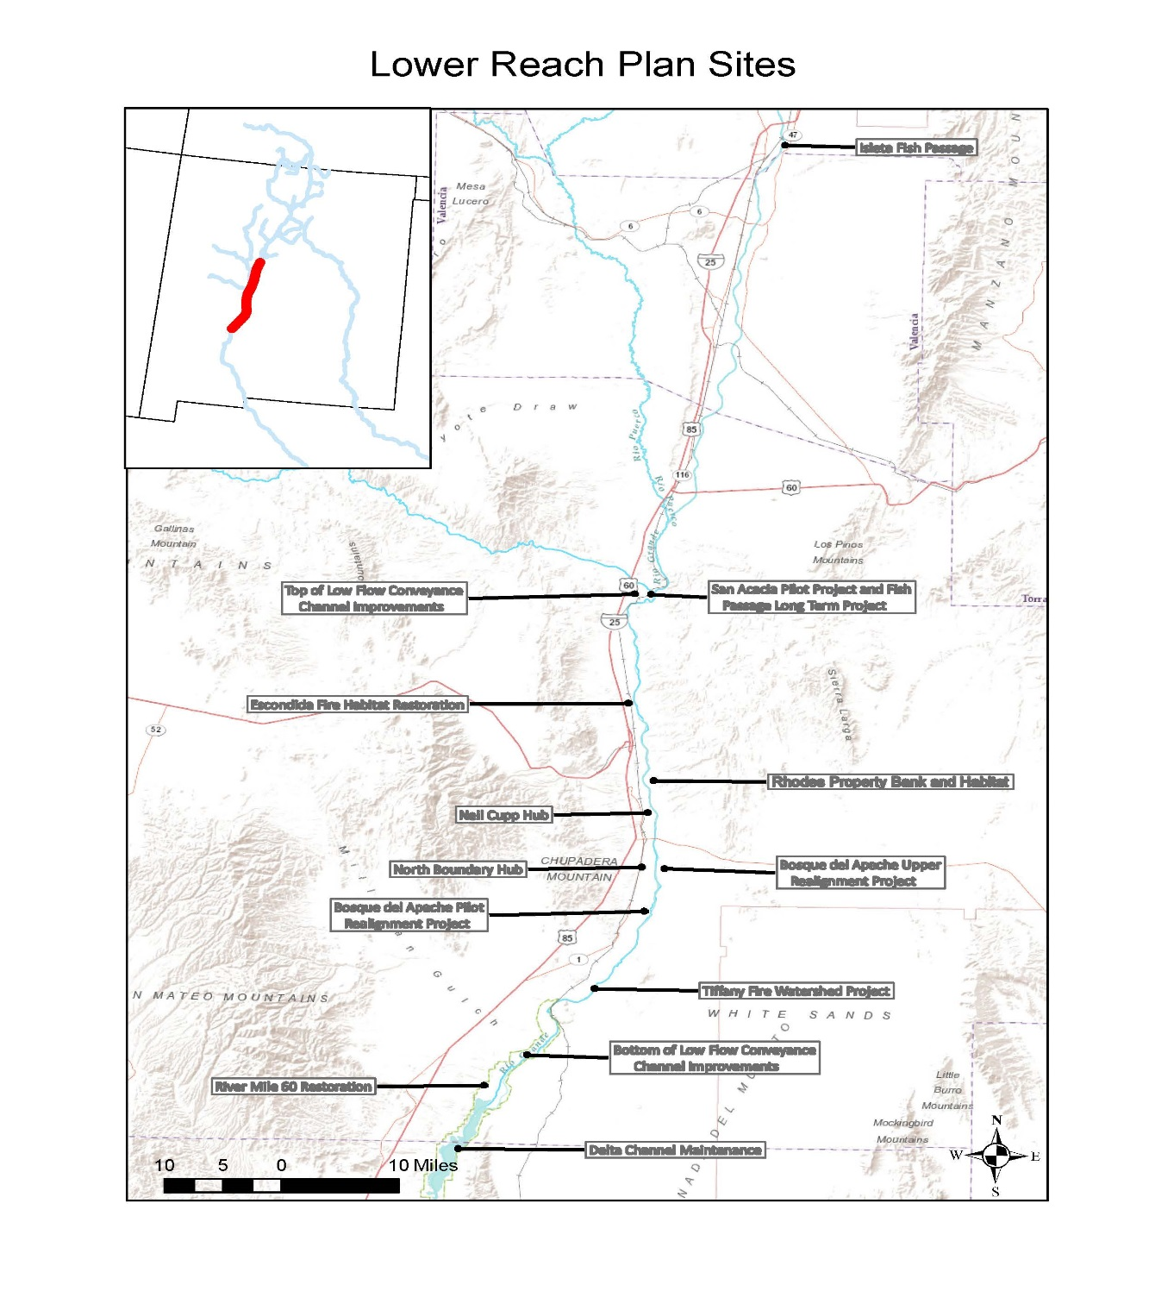

Slide 4
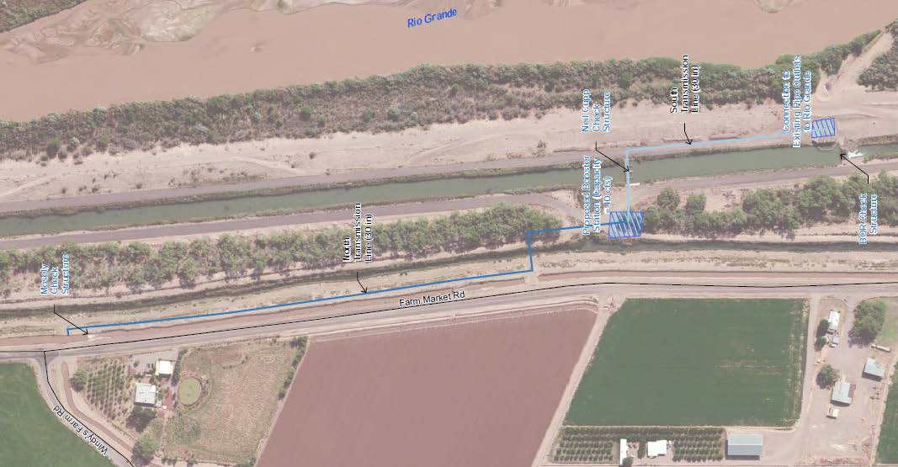
Socorro Main Canal S. Distribution Hub (Neil Cupp) RM 90 – In cooperation with MRGCD through a WaterSmart grant, utilizing the existing Neil Cupp check structure along with a new check structure to be built in the Socorro Riverside Drain “A” to supply water to the Socorro Main South. Also, existing infrastructure through the spoil levee will be used to discharge flow to the Rio Grande to augment river channel flows for the silvery minnow, with possible benefits to flycatcher and cuckoo habitat, depending on water availability and river conditions. (Construction Fall 2018 – 2019)

Slide 5
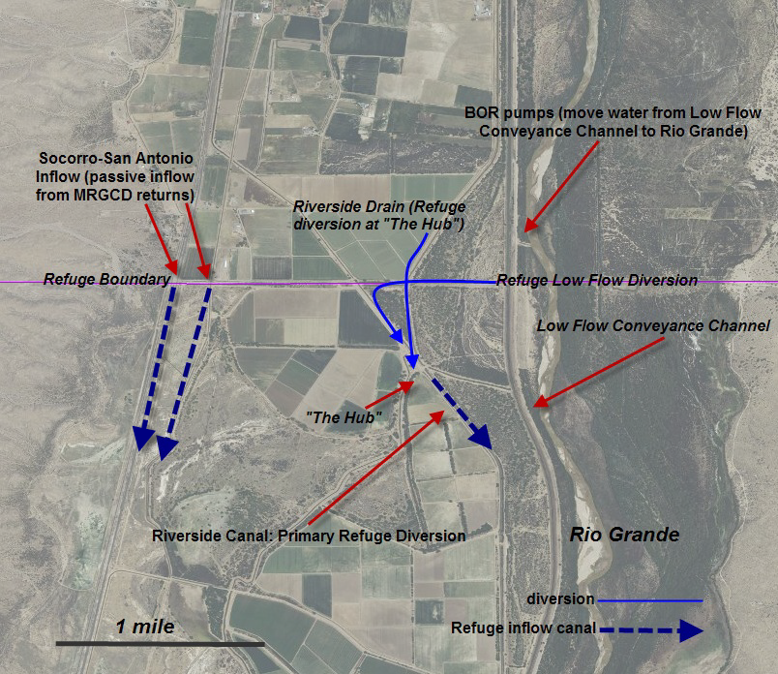
BdA North Boundary Infrastructure RM 84 – Reconfigure the infrastructure at the north boundary of BdA to provide increased water supply stability during droughts, keep a stable flow for the mouse on BdA and support their management needs. MRGCD tailwater off of the Socorro and San Antonio Main Canals towards the LFCC and a gravity fed channel to the Rio Grande would be included in the design. Additionally, the project would allow for greater flexibility with water management in this critical area. (Construction Jan – April 2019)

Slide 6
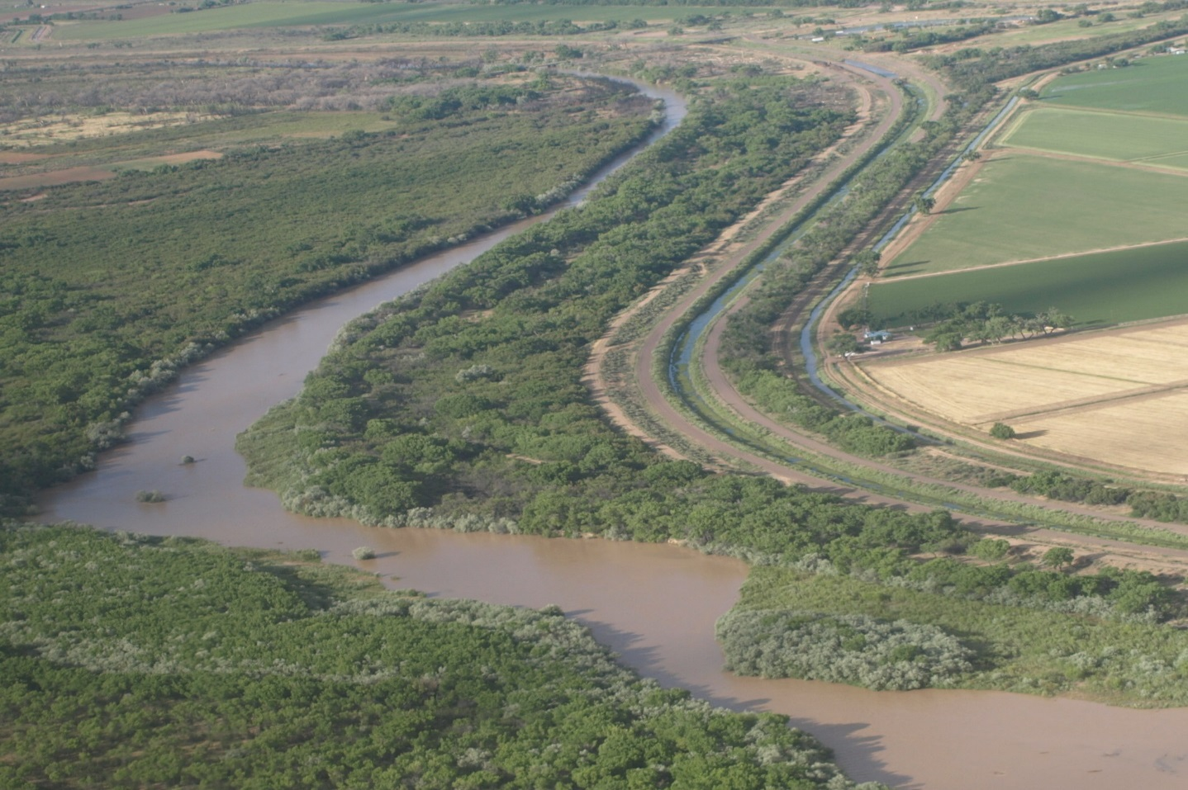
LFCC Improvements - Create a plan to determine the movement of groundwater through the LFCC/River Channel System to include the LFCC, Drains & Canals, and the main river channel. Modeling will be used to identify the sections of the LFCC or the River Channel where seepage is negatively impacting water delivery and habitat for federally listed species. The modeling will be utilized to determine efficient ways to minimize water loss throughout the system. (Construction Fall 2019)

Slide 7
San Acacia Pilot Study RM 116.2 – Evaluates current conditions at the San Acacia Diversion Dam that may prevent movement of fish (esp. RGSM) upstream past the diversion dam; assesses fish movement in key areas on and downstream of the dam; and, design and implement pilot projects to test the feasibility of a permanent in-channel fish passage by infrastructure and operational modifications.
Note: In 2017, Reclamation determined that the placement of pilot fish passage structures, even if temporary, was of concern given the age and current condition of the diversion dam, and that maintenance efforts to fortify the downstream portion of the diversion dam needed to occur first. While the diversion dam and gates are in good condition, the rock material located below the diversion dam, which protects from undercutting due to continued channel degradation, must first be reinforced.

Slide 8
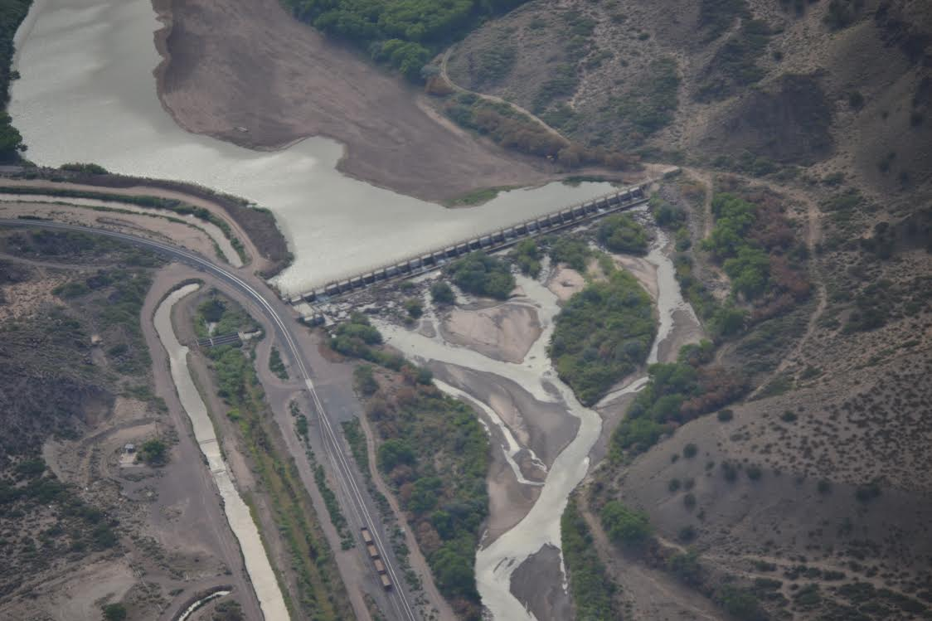
Fish Passage San Acacia Long Term Project RM 116.2 - Reclamation will utilize and integrate the results of the San Acacia Pilot Study into the long-term river connectivity measures. (Construction 2020-2021)

Slide 9
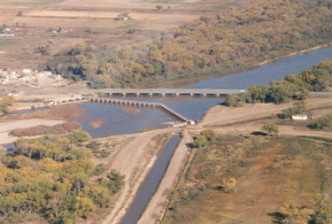
Fish Passage Isleta Diversion Dam RM 169.3 – Reclamation, in cooperation with the Isleta Diversion Dam Technical Team, will develop conceptual designs for multiple options for fish passage at the IDD. Develop a written plan for further evaluation of the conceptual designs, as well as for development of a final design. (Construction 2020-2023)

Slide 10
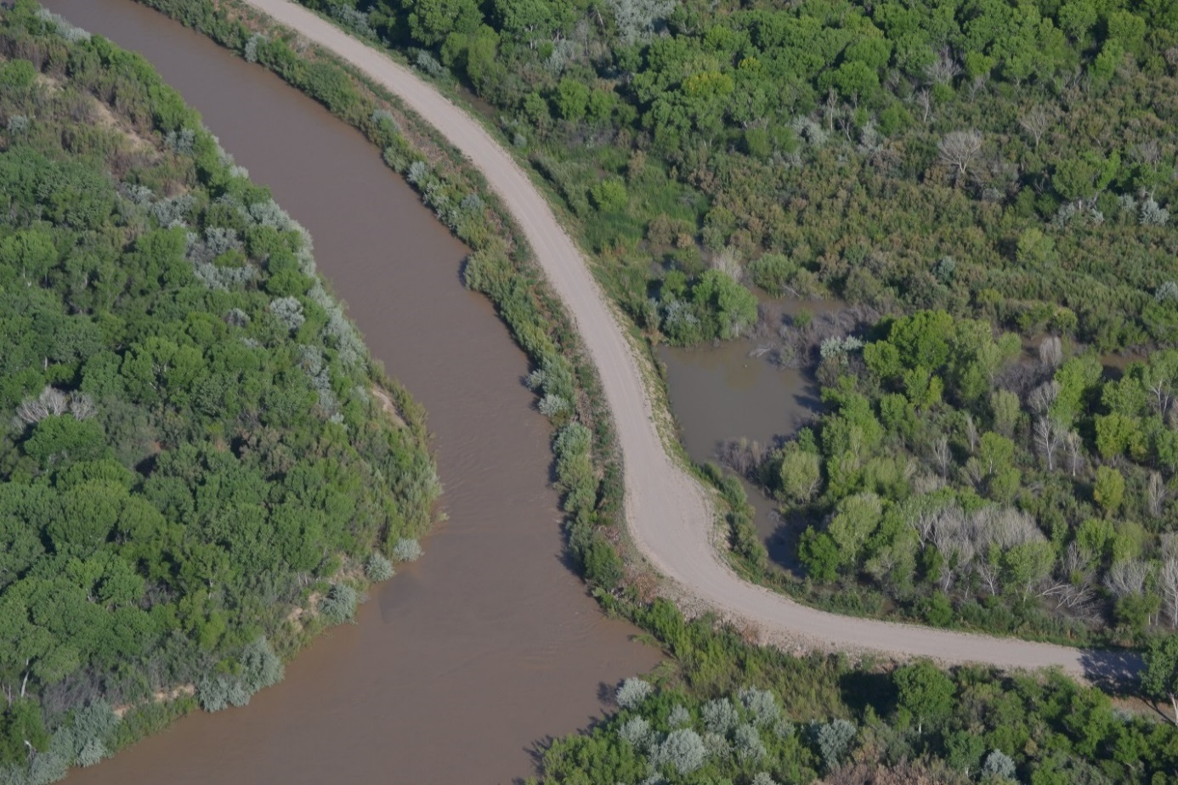
River Maintenance and Restoration Program- RM60 Restoration - Increase and improve existing habitat which is in a decline due to age; improve water delivery from the LFCC to the river during winter months; improve sediment management from the LFCC to the river which will reduce maintenance costs. This work would include installation of a control structure from the LFCC into the Rio Grande at RM60. Coordinated water releases from the proposed control structure, may serve to aggrade the Rio Grande riverbed to its historical elevation prior to the LFCC construction. In addition, the infrastructure may augment habitat restoration efforts to improve ecosystem functionality/suitability for endangered species. (Potentially 2019, pending multi-agency reviews)

Slide 11
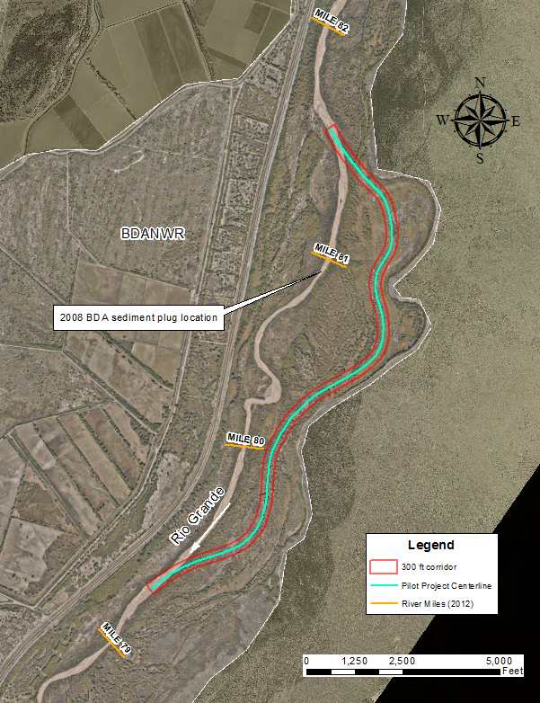
BdA Pilot Realignment Project RM 79.3 – 81.5 -
Promote long-term effective conveyance of water and sediment through the reach while minimizing the potential for spoil levee and LFCC failure which would lead to significant depletions. The project will also create and improve aquatic, wetland, and native riparian habitat that would benefit listed species. It was determined that the excavation of the inlet and outlet only was more appropriate from an engineering and logistical perspective than excavating a continuous channel. The realigned channel will address, or bypass the area where the 2008 and 2017 sediment plugs occurred. (Construction 2018)

Slide 12
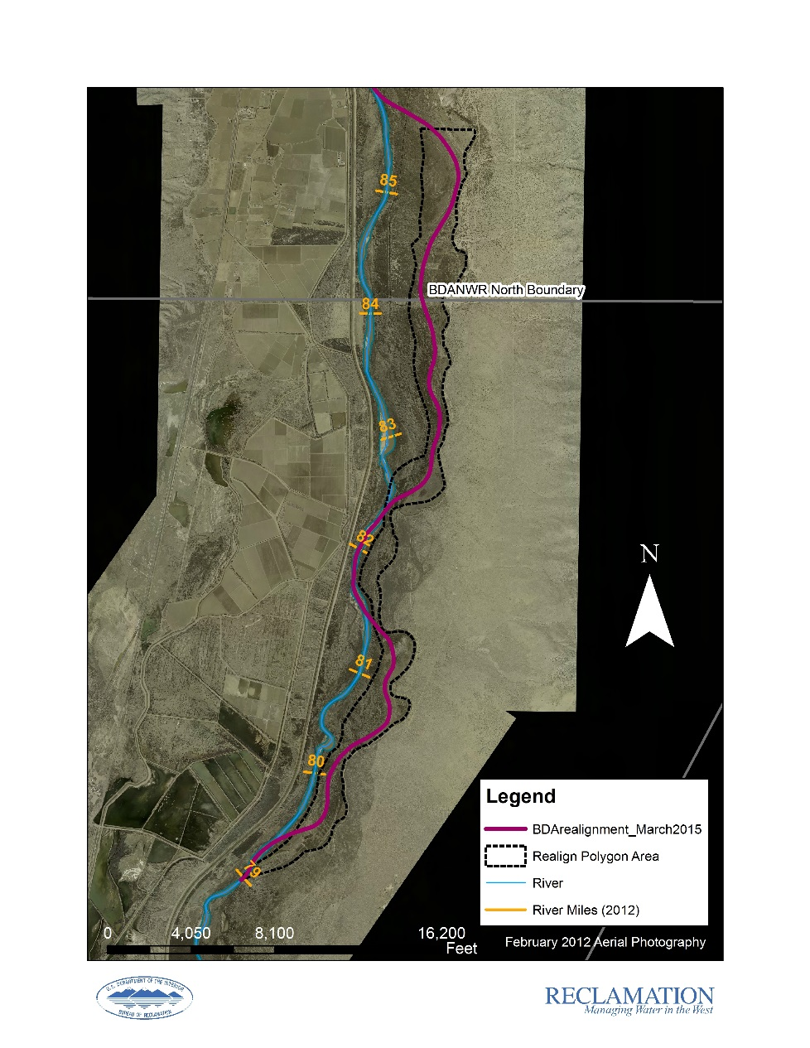
BdA Upper Realighment RM 79 – 85.5 -This 4.5-mile realignment is located just upstream of the pilot realignment. If the pilot project achieves its goals, the upper realignment will move forward and any lessons learned from the pilot project will be used to improve the design of the upper realignment project. (Construction 2020)

Slide 13
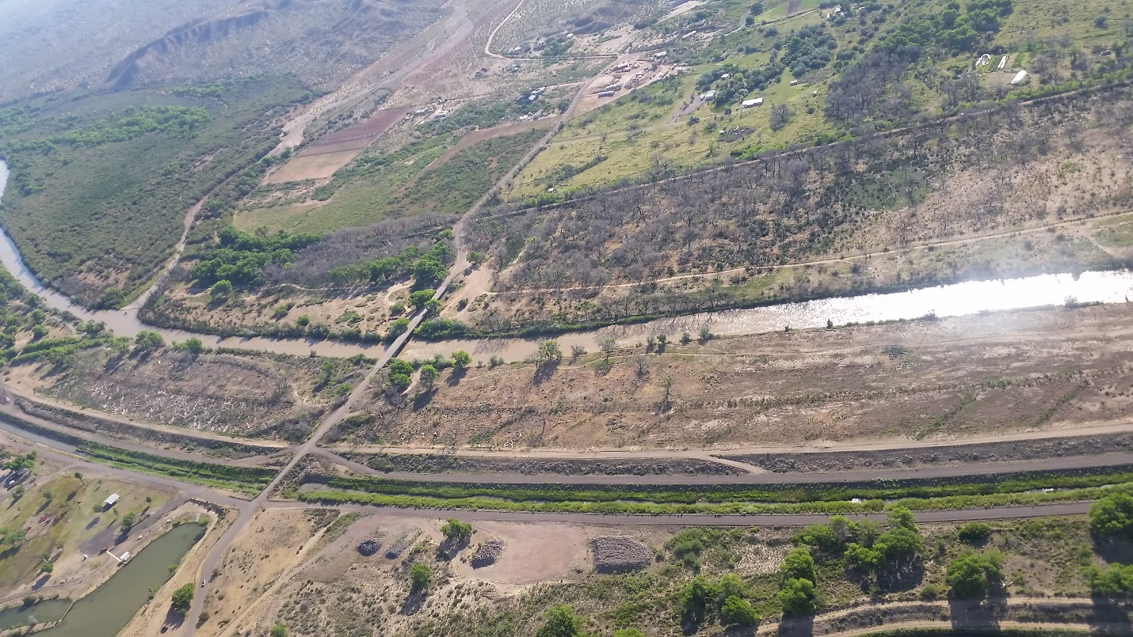
Escondida Fire Habitat Restoration RM 104 – A wildfire burned the area in June 2016. The goal of this project is to rehabilitate the burn area and create nursery habitat for the silvery minnow, with some areas inundating at flows as low as 500 cfs. The project will also possibly provide secondary benefits for the flycatcher and cuckoo. (Construction 2018)

Slide 14
Rhodes Property Restoration RM 94 - Reclamation is proposing a bank line lowering effort in partnership with the owner of the Rhodes Property. The project is in the early planning stages and proposes to remove bank line material in a terraced fashion to allow for shallow inundation to occur at multiple river stages which builds off the geomorphic analysis of the Arroyo de las Canas Reach (RM 101-89). (Construction Fall 2018)

Slide 15
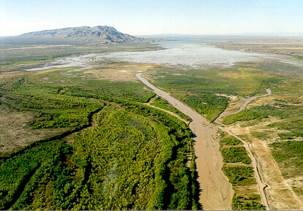
Delta Channel Maintenance RM 57.8 to Ebutte Active Pool – Cooperative Agreement with ISC, focus on maintaining existing berms, management of sediment accumulation, and the management of vegetation growth within the channel cross section to maintain a target conveyance capacity. Breaks in the berms of the Delta Channel may be provided for the purpose of allowing natural drainage into the channel and to prevent water from accumulating behind the berms. It is estimated that these breaks benefit approximately 245 acres of habitat for flycatchers/cuckoos. (Fall/Winter Annually)

Slide 16
Data Collection Efforts
Hydrographic Data Collection and Modeling: Sediment Management/Elevation Plan Hydrographic data collection routinely occurs as part of Reclamation’s river maintenance activities. This data is collected for specific project purposes or more comprehensive reach evaluations and analyses. Typically, project specific data is collected during or immediately after peak flow conditions as these time intervals represent the conditions for most projects.
MRG Monitoring in Lower Reaches - Reclamation is currently developing a comprehensive MRG Monitoring Plan to better integrate the various monitoring Reclamation conducts in the MRG.
This Plan will serve as an overarching guidance document for monitoring efforts and include monitoring conducted in the Lower Reaches. Adaptive management will help guide the collection of monitoring data in the Lower Reaches and help to ground-truth what effects result from these projects, to evaluate assumptions and determine if revisions or updates may be appropriate, and to inform future project designs.

Slide 17
Adaptive Management
Because of the complexity of the MRG system hydrology, geomorphology, and tributary inputs and the variability of silvery minnow demographics, as well as other background trends, uncertainties exist related to the relationships between MRG hydrology and listed species. Given these uncertainties, the use of Adaptive Management (AM) is particularly appropriate within the context of species-hydrology relationships that inform water operations and management.
AM is useful in resolving uncertainties and informing management on other projects and activities, such as fish passage, habitat restoration, and species monitoring.
The Service expects that the use of AM will allow Reclamation, BIA, and the BiOp Partners to maximize conservation benefits under varying river conditions, and still provide for the needs of the MRG Water Managers.
Also, Reclamation and the BiOp Partners will implement a defined active AM process involving an interdisciplinary team of biologists, geomorphologists, hydrologists, and engineers, and in coordination with other agencies and stakeholders, to address critical uncertainties about management-relevant aspects of listed species habitat. Reclamation will also implement a more traditional passive AM process to assess performance of actions.

Slide 18
Lower Reach Depletions Analysis
The New Mexico Office of the State Engineer (OSE) has had a policy in place since 2011 that governs permitting and river depletions due to river maintenance and habitat restoration projects (OSE memo from J. D’Antonio, “Depletions Offsetting for Habitat Restoration Projects within the Middle Rio Grande Project,” October 28, 2011).
In short: (1) permitting is not required for projects conducted by Reclamation, the USACE, or the NMISC “within the Middle Rio Grande floodplain (defined as levee to levee) between Velarde and Elephant Butte Reservoir because of their respective flood control authorities and/or compact delivery statutory roles. . . .the end result of the work is a functional MRG floodway and floodplain which is important to the State and it[s] citizens for a number of reasons”, and (2) depletions caused by habitat restoration work outside of the river channel, defined as a 600-ft wide corridor centered on the midline of the river, are subject to offsetting requirements set by the OSE.
Reclamation has long been committed to limiting the size and location of habitat restoration projects in the MRG such that there are no new net depletions. However, because this LRP includes several habitat restoration projects that could occur outside of the river channel, Reclamation will be pursuing a reach-wide depletions analysis and agreement with the State that balances depletions caused by habitat restoration projects with gains realized from projects designed to increase efficiencies in water use and delivery.

Slide 19
Other Projects in the Project Area
Save Our Bosque Task Force
U.S. Army Corps of Engineers
BLM
NM State Forestry

Slide 20
Next Steps:
March 13 – Present at SOBTF
April – Finalize Lower Reach Plan Report
May – Submit report to US Fish and Wildlife Service

Slide 21
Questions?

